Slide 1
Design Study
Baker Belongings Frontend UI

Slide 2
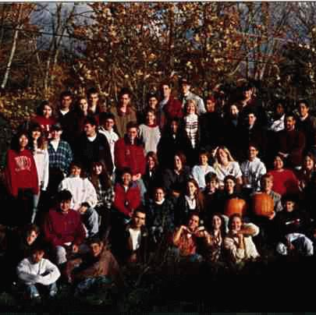
Color Design
The warm, fall colors and nature of the early photography style evokes the warm, happy nature of this photo. The goal for this color design is to maintain the community-centric feeling of this photo.

Slide 3
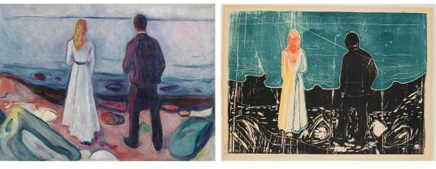
Edward Munch
In a series of prints titled “Two Human Beings (The Lonely Ones)”, Edvard Munch repeatedly depicts a man and a woman standing apart on a beach. Throughout this series of artworks, the poses and general shapes remain the same, with the only thing changing each time being the color scheme. With the changing color scheme, the same pose evicts strikingly different emotions from the viewer. For example, the print on the right feels desperate and intense, the left-hand print is more serene and tender. The left hand side is more applicable to my use case.

Slide 4
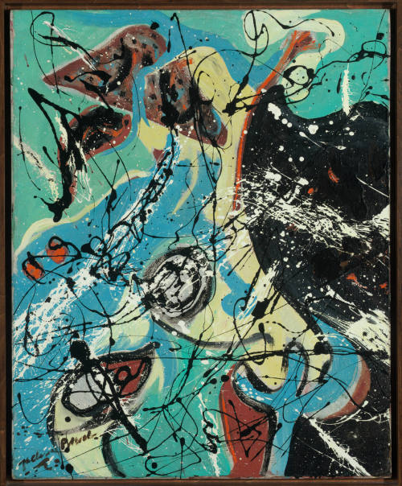
Jackson Pollock – Winter Birds
Looking more specifically at the choice of colors and what emotions they create, this abstract art by Pollock uses a somewhat similar array of colors as in the right version of the “Two Human Beings”, but with a more muted tone as is found in the left version. This feels livelier in contrast with either of the Munch artworks.

Slide 5
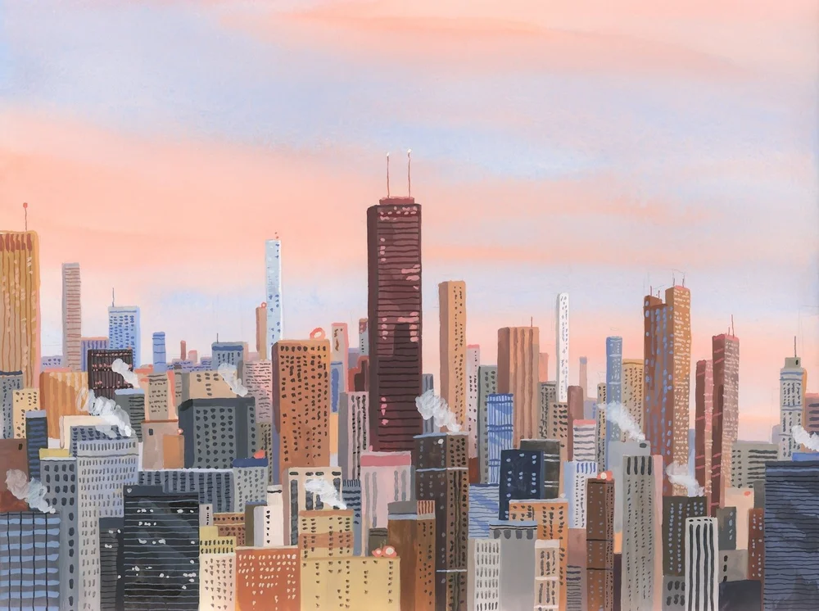
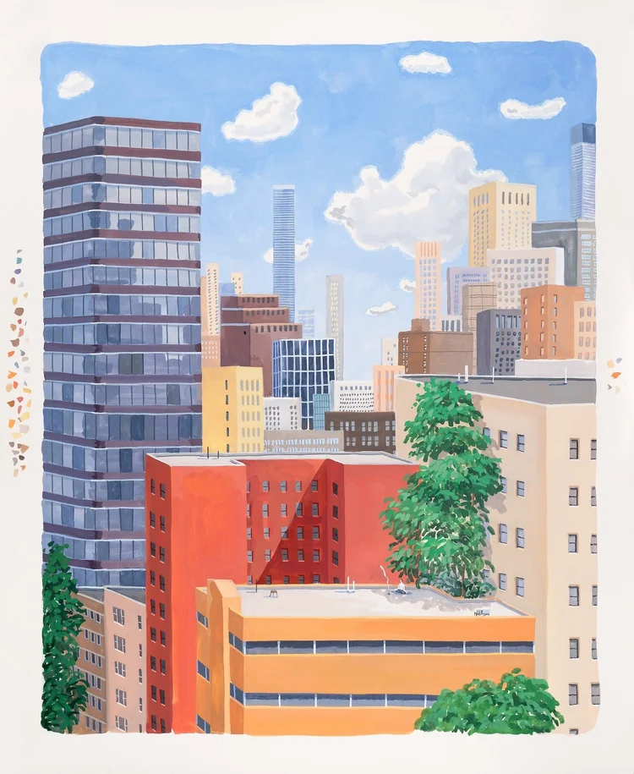
Seula Yi - City Life
Seula Yi is a contemporary artist who has made a series of artworks depicting the feeling of city life. Although her work has a range of scenes and emotions, these two are the closest to what I would want to emulate in the Baker website. Yi uses a bright color palette in the bottom image with incredibly rich tones, conveying the feelings of hope and happiness. The emotions are somewhat toned down along with the saturation of the colors in the top image, which leads it further from a strict sense of hope to a more general feeling of peace.

Slide 6
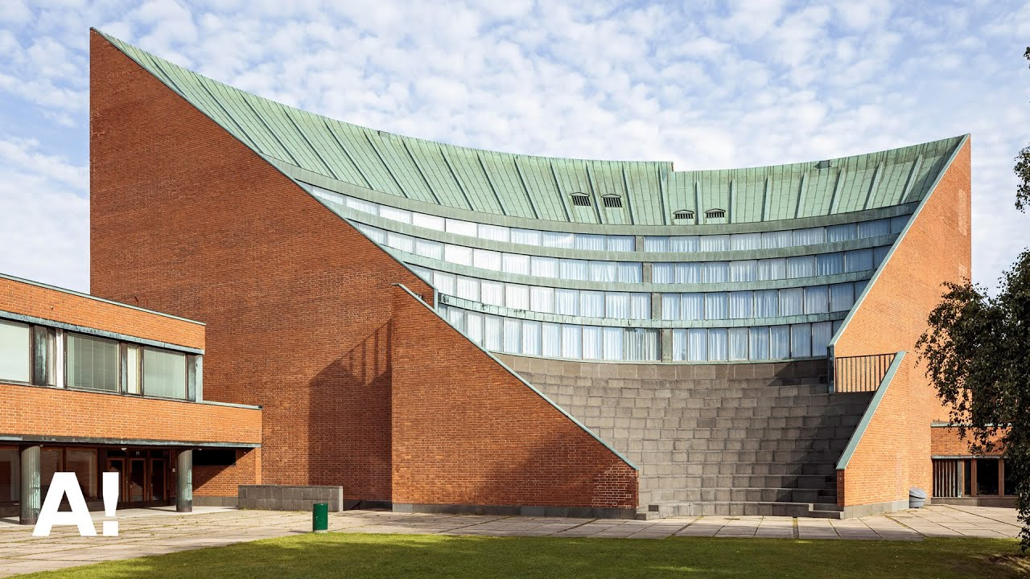
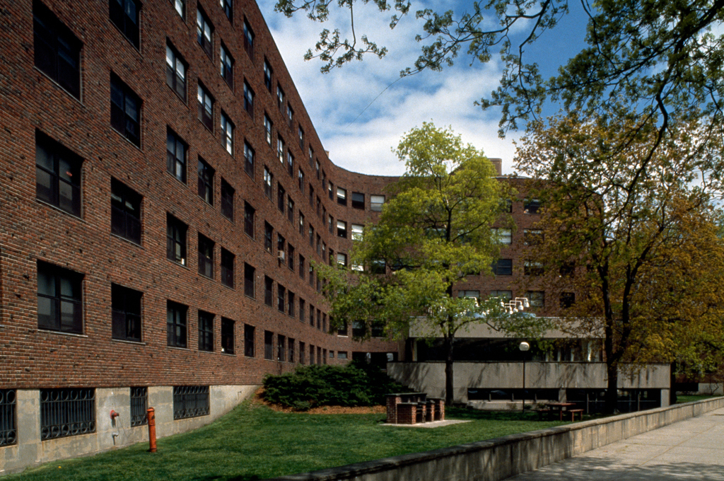
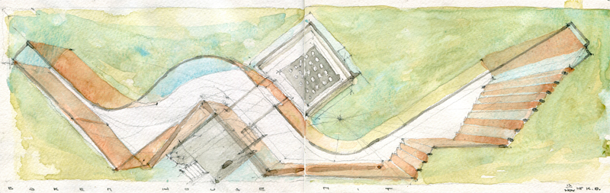
Alvar Aalto
Alvar Aalto is the very famous Finnish architect, whose only piece of work in the United States being Baker House. On the top left is an example of his design in Finland, top right is a close-up view of Baker on campus, and bottom is a sketch of Baker. He built the dorm with one continuous hallway per floor, as seen in the bottom sketch. This creates a flow that passes through the entire building and created open spaces for community building.
The warm tone of the bricks set against a cool blue sky and warm greens conveys a feeling of peace and happiness, as demonstrated through the past works of art discussed. This spread of colors is largely split complementary, with greens and blues and reddish browns and shades of those colors.

Slide 7
Summary
The goal of this application is to facilitate community. For this reason, the final palette will be some combination of the palettes previously discussed.
Final Palette
The final palette is bright and hopeful, but keeps the throughline of the brown as found in the sunset city, as well as from the bricks from the building itself. The top, greenish tint should be used as an accent and sparingly, relying more heavily on the darker sea-green in the fourth color.

Slide 8
Color Collage

Slide 9
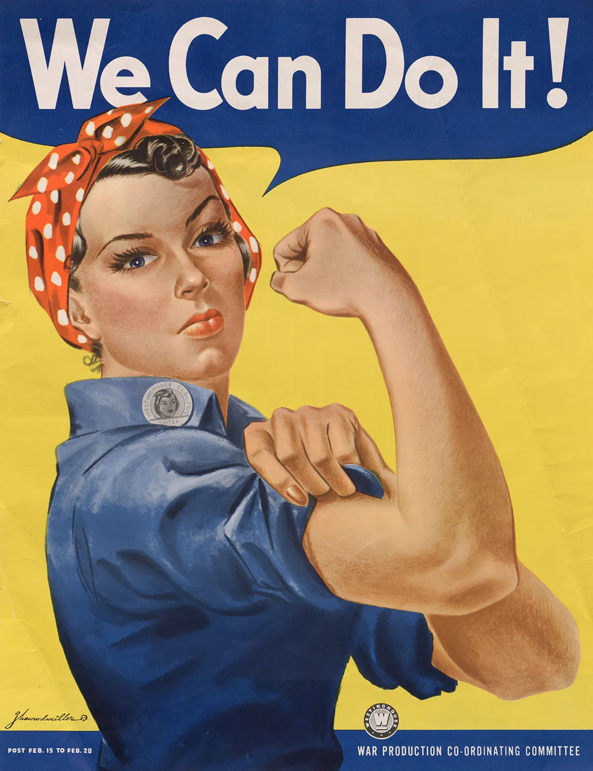
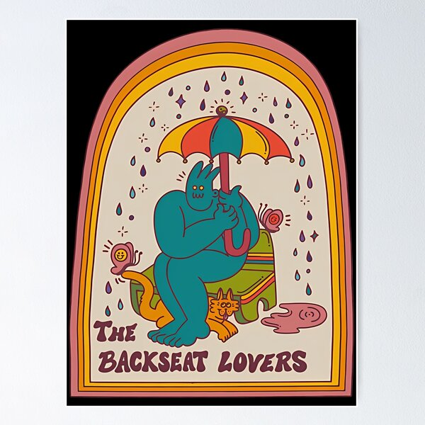
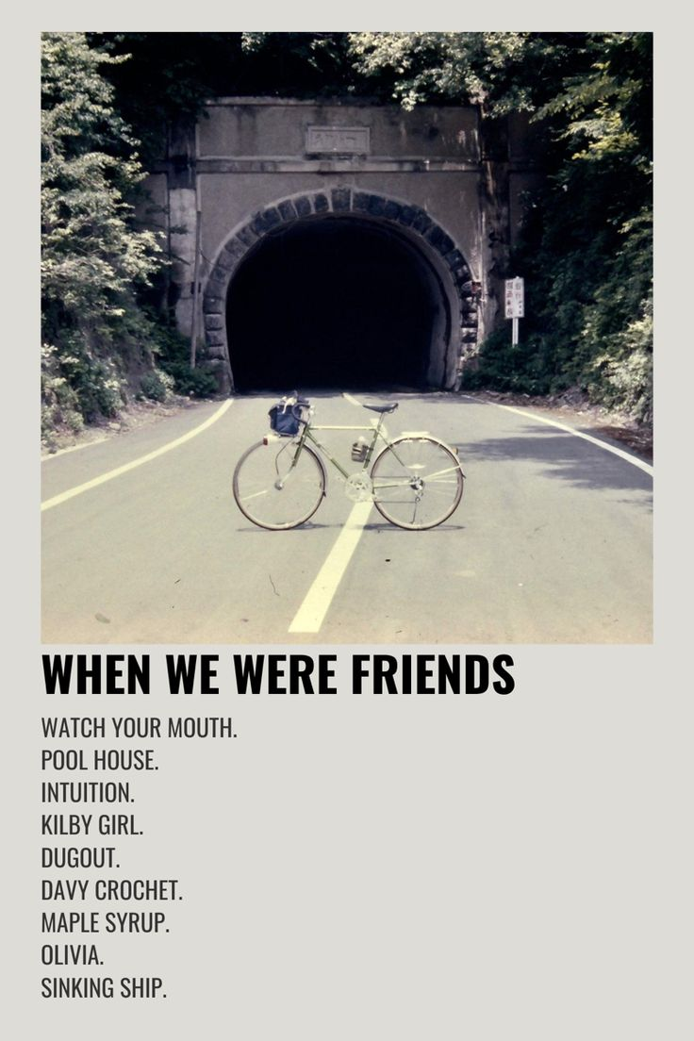
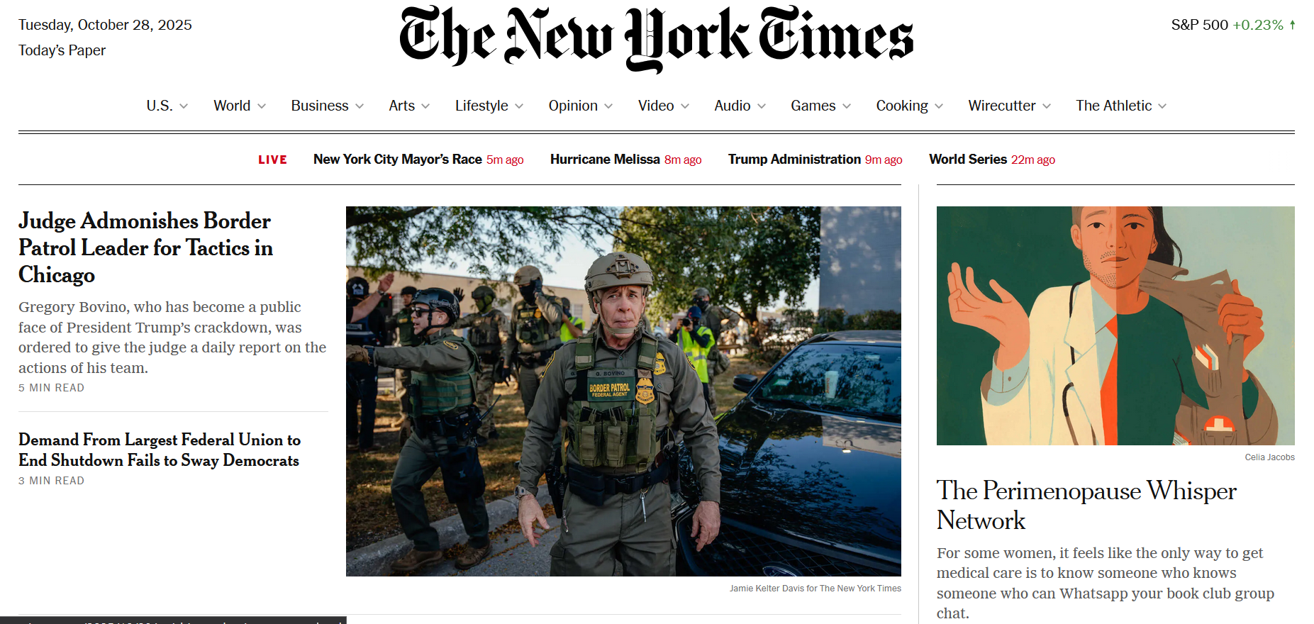
Typography Collage
Low x-height, heavy weight, emphasizes each word separately
NYTimes: Uses several different font faces, but largely distinguishes between headings and body text by font weight and size. Heading font uses very low x-height, body font uses high x-height.
Shaky bubble lettering, all caps; interesting, but would be reserved for a central title / logo
Like the sans-serif, but difficult to read

